Slide 1
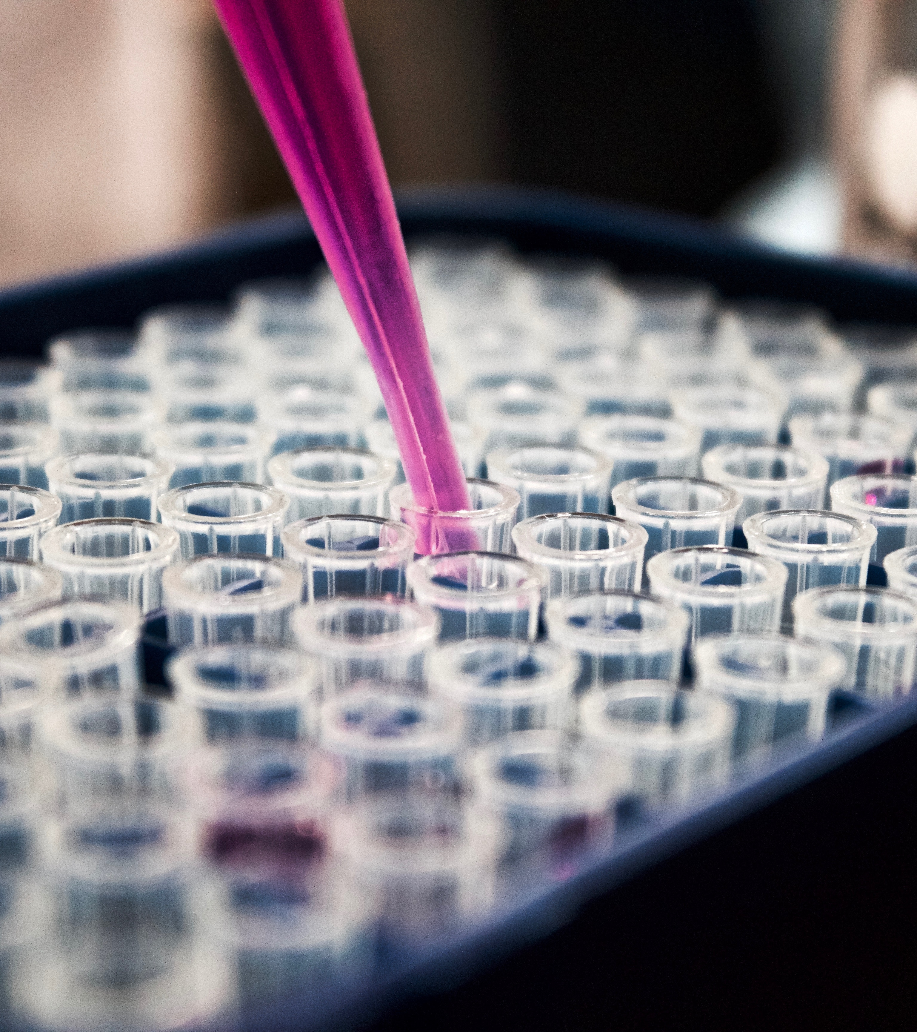

Using Machine Learning for identifying Malignant Tumors
Ashish Gupta

Slide 2
AGENDA
Problem Statement
Subject Sample Data
Exploratory Data Analysis Results
Broad Approach
Classification Algorithms
Decision Trees
Random Forest
k- Nearest Neighbor
Final Recommendations

Slide 3
Problem Statement
Demonstrate Machine Learning Techniques to predict malignant tumors based on subject Fine Needle Aspiration (FNA) data of breast tissue masses.

Slide 4
Subject Sample Data

Slide 5
Sample Dataset – What is the sample data?
Dataset consists of 500+ measurements from Fine Needed Aspirations of breast tissue masses.
Each measurement contains 30 summarized measures/ variables (Mean, Standard Error of the Mean, and Worst Value of all 10) of cell nuclei for following characteristics:
Radius
Texture
Perimeter
Area
Smoothness
Compactness
Concavity
Concave Points
Symmetry
Fractal Dimensions

Slide 6
Sample Dataset – Structure
Diagnosis (Benign / Malignant)
radius_mean | radius_se | radius_worst
texture_mean | texture_se | texture_worst
perimeter_mean | perimeter_se | perimeter_worst
area_mean | area_se | area_worst
smoothness_mean | smoothness_se | smoothness_worst
compactness_mean | compactness_se | compactness_worst
concavity_mean | concavity_se | concavity_worst
concave_points_mean | concave_points_se | concave_points_worst
symmetry_mean | symmetry_se | symmetry_worst
fractal_dimension_mean | fractal_dimension_se | fractal_dimension_worst
500 Observations
Total 31 variables
1 Response Variable
30 Predictor Variables

Slide 7
Sample Dataset – How is it collected?
In an FNA, a small needle is used to extract a sample of cells from a tissue mass. The cells are then photographed under a microscope.
The resulting photographs are entered into graphical imaging software.
A trained technician uses a mouse pointer to draw the boundary of the nuclei.
The software then calculates each of ten characteristics for
the nuclei.

Slide 8
Exploratory Data Analysis Findings

Slide 9
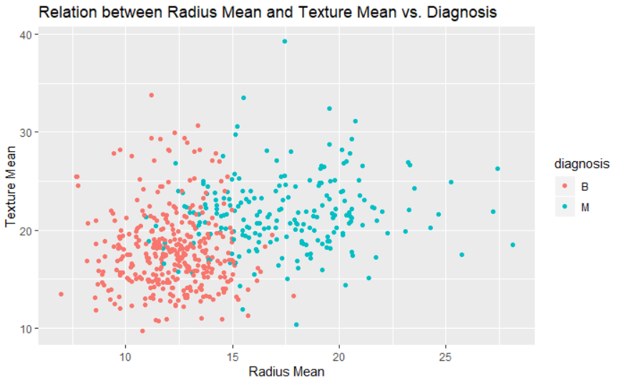
Exploratory Data Analysis
Distribution of benign and malignant tissue mass by average radius and texture of the cell nuclei.

Slide 10
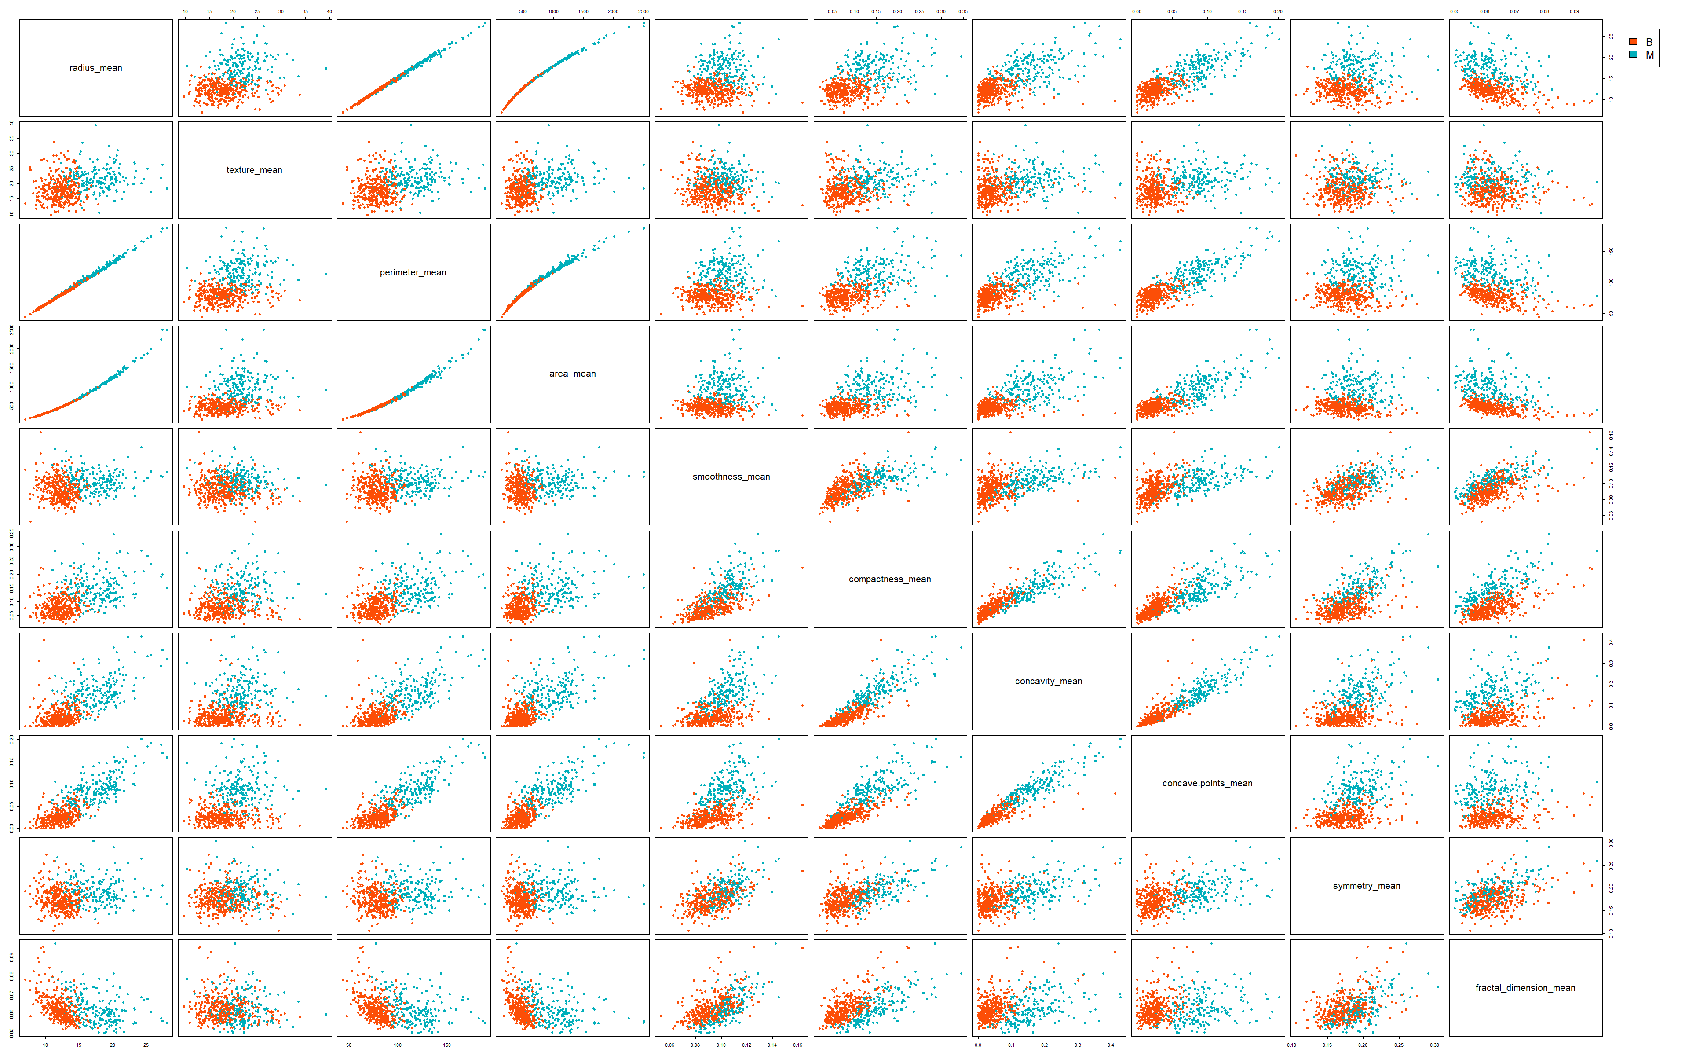
Paired Scatter Plots of Mean Values

Slide 11
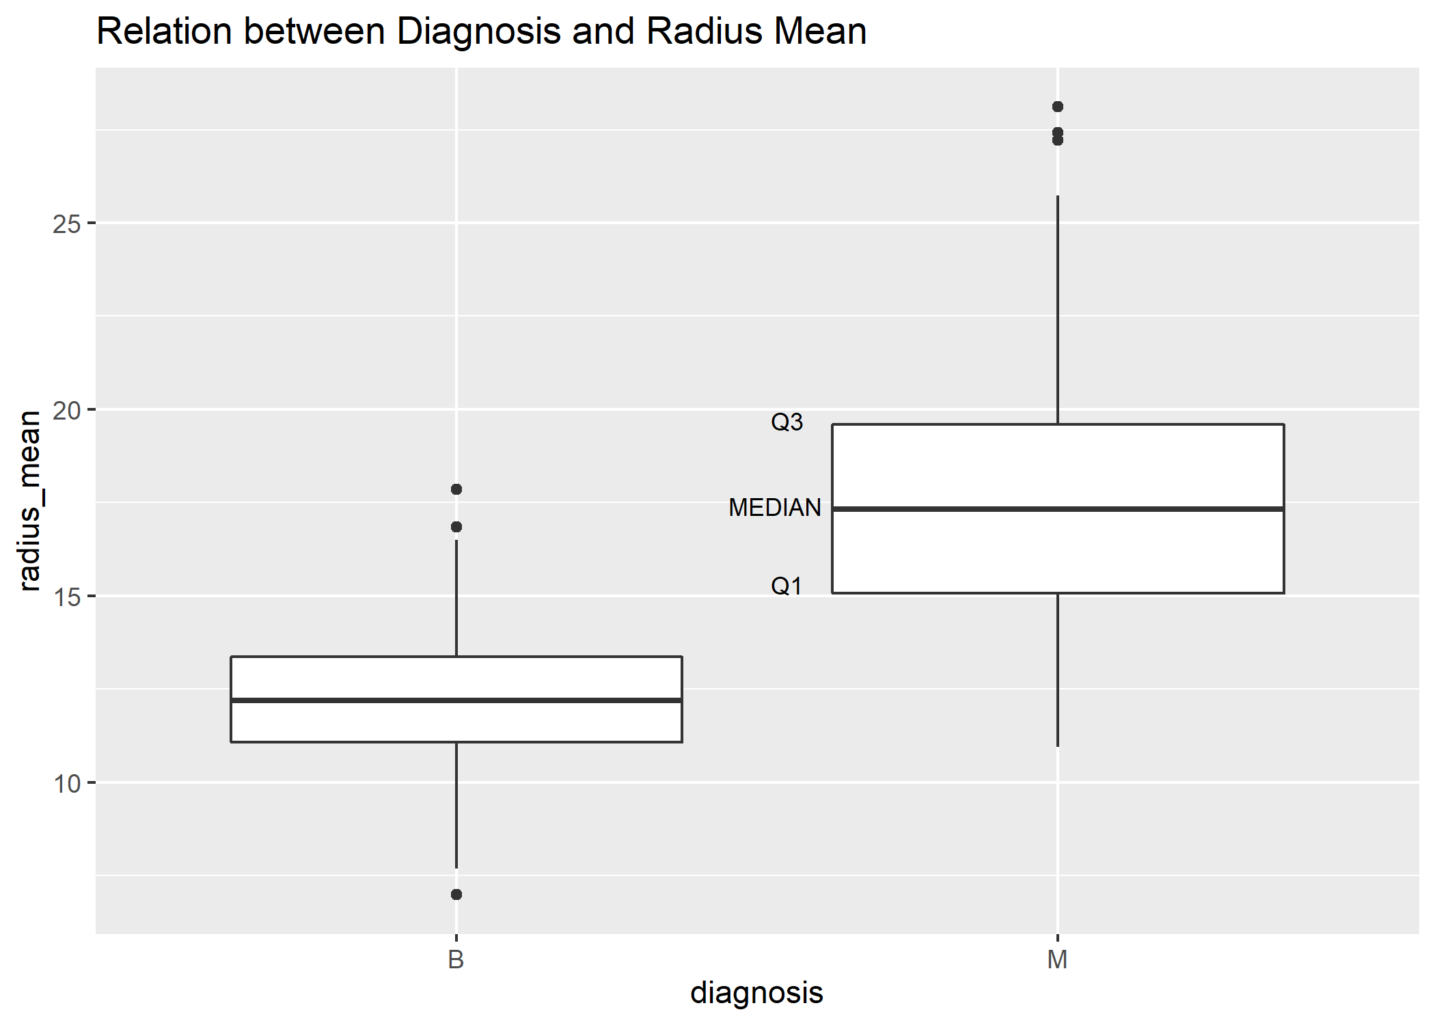
Box Plots of Average Radius
Q1: 25% of the data is at and below the line
Median: 50% of the data is at and below the line
Q3: 75% of the data is at and below the line

Slide 12
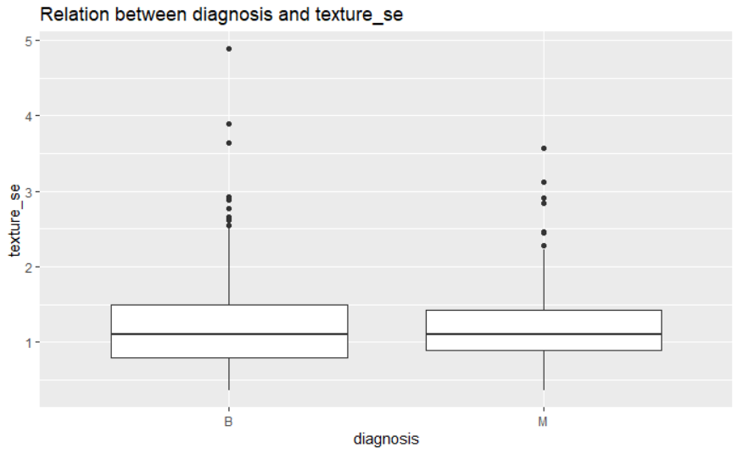
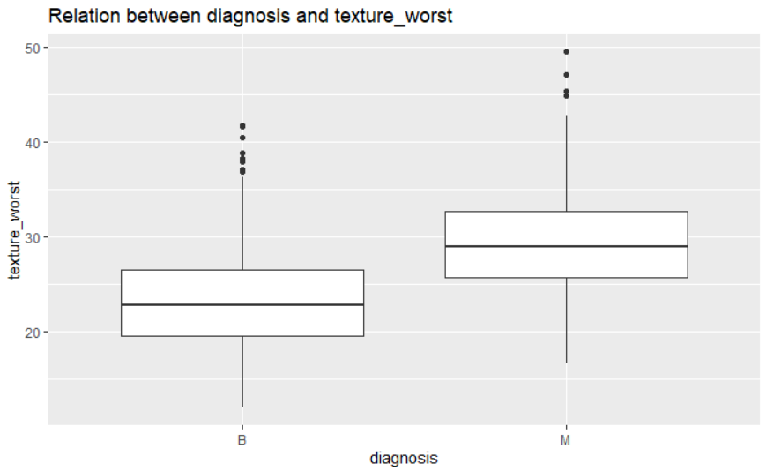
Box Plots of Average Radius
Texture Standard Error
Maximum Texture

Slide 13







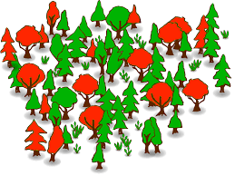

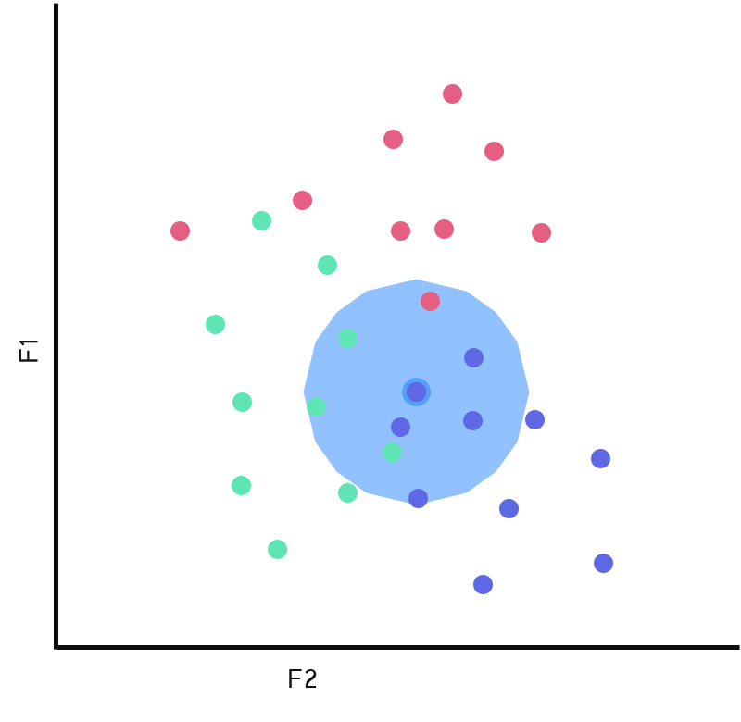
Broad Approach - How do we do this?
Sample Data
Sanitized Data
Training Data
Test Data
Data Cleansing
Exploratory
Data Analysis
Decision Trees
ML Classification
Algorithms
Random Forest
Best-Fit
Classification
Model
k – Nearest
Neighbor

Slide 14
Classification Algorithms
Decision Trees
Random Forest
k – Nearest
Neighbor

Slide 15
ML - Classification Algorithms
It’s ML technique/computer algorithm for learning to predict the response for new dataset using historical sample data.
It predicts classifier values (Yes/No, Benign/Malignant ….).
It’s a 2 step-process:
Learn – Model is developed based on training data.
Predict – Model is used to predict the response.
We pick the best fit model based on assessing
the prediction accuracy by comparing it
with historical data.

Slide 16
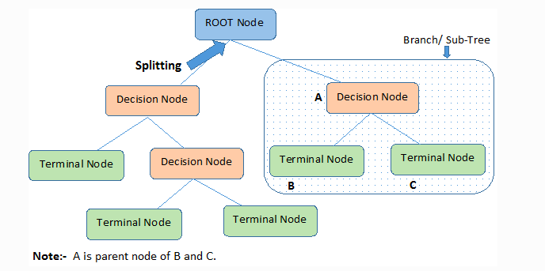
Decision Trees – General Overview
It creates training model that can do predictions by learning simple decision rules.
Trained Model appears as a tree-type structure, consisting of nodes of following types: Root, Decision & Leaf/Terminal.

Slide 17
Decision Trees – How does it work?
Each node in the tree acts as a test case for some attribute.
Each edge descending from the node corresponds to the possible answers to the test case.
This process is recursive in nature and is repeated for every subtree rooted at the new node.
The process stops at a leaf node where classification
value is assigned to the response variable.

Slide 18
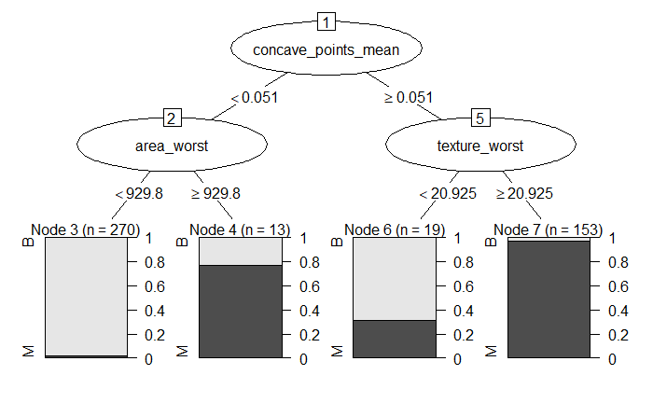
FNA Best-fit Prediction Model – Decision Trees
Prediction Accuracy = 89.5 %
Recommended Predictor Variables:
Concave_Points_Mean
Area_Worst
Texture_Worst
Assuming misclassifying a malignant as benign is worse, this model
gives a 6.1 % of such
misclassification.
Predicted Outcomes | Actual Outcomes
 | Benign Tissue Mass | Malignant Tissue Mass
Benign Tissue Mass | 65 | 7
Malignant Tissue Mass | 5 | 37

Slide 19
Random Forest Prediction Model

Slide 20
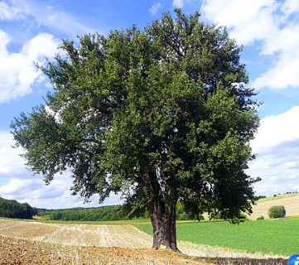
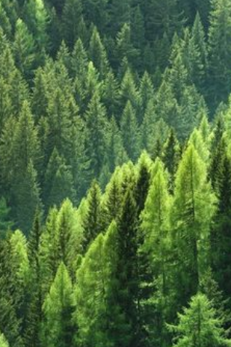
Random Forest Model
A model of 1 decision tree can have high bias due to outliers, or heavy emphasis on 1 of the characteristics.
Random forest model is a collection of decision trees, increasing randomness and dampening bias.

Slide 21
Random Forest Model Result
The table below shows out of 114 test observations, 64 were
predicted correctly as benign and 44 as malignant.
The random forest model has an accuracy rate of 94.7%
Assuming misclassifying a malignant as benign is worse, this model gives a 2.6% of such misclassification.
Predicted Outcomes | Actual Outcomes
 | Benign Tissue Mass | Malignant Tissue Mass
Benign Tissue Mass | 64 | 3
Malignant Tissue Mass | 3 | 44

Slide 22
k–Nearest Neighbor Prediction Model

Slide 23

k–Nearest Neighbor Prediction Model
k = 3, Green Circle is classified with Red Triangles
k = 5, Green Circle is classified with Blue Squares

Slide 24
k–NN Prediction Model Results
k-NN classification has an accuracy rate of 92.1%
Assuming misclassifying a malignant as benign is worse,
this model gives a 7.7% of such misclassification.
Predicted Outcomes | Actual Outcomes (k = 3)
 | Benign Tissue Mass | Malignant Tissue Mass
Benign Tissue Mass | 67 | 9
Malignant Tissue Mass | 0 | 38

Slide 25
Initial Conclusions
Random Forest has the highest rate of accuracy
Random Forest also has the lowest rate of false negatives
This combination of factors proves Random Forest to be a
viable model for diagnosis
Model | Accuracy
 | Overall Accuracy | False Negative Rate
Decision Tree | 89.5 | 6.1
Random Forest | 94.7 | 2.6
kNN | 92.1 | 7.7

Slide 26
THANKS!
Any questions?

